Slide 1
Project Overview Specification Document
Axon Guidance
Steve Salmons, Salil Nizar, Forrest Slater, Morgan Darke

Slide 2
What is the Project Overview Specification?
Shows a high-level understanding of the context of the project.
Defines the scope of the project.
Sets expectations of sponsor and team.

Slide 3
Contents of Product Overview Specification
Introduction
Product Sponsor and Sponsor Need
Method for Satisfying the Sponsor’s Need
Technical Proposal
Management Proposal
Conditions and Comments
Approvals
Appendices

Slide 4
Contents of Product Overview Specification
Introduction
Product Sponsor and Sponsor Need
Method for Satisfying the Sponsor’s Need
Technical Proposal
Management Proposal
Conditions and Comments
Approvals
Appendices

Slide 5
Project Sponsor and Sponsor Need
Consists of:
Sponsor Identification.
Sponsor’s “Business”.
Description of the Need.

Slide 6
Sponsor Identification
Who is the sponsor?
Use the complete organization name.
Names and titles of project contacts at organization.

Slide 7
Sponsor’s “Business”
What does the sponsor do?
How is their business organized?
How do they provide goods/services?
Where does the project fit in terms of the sponsor’s business?

Slide 8
Description of the Need
What does the project need to accomplish?
What constraints has the sponsor provided?
Vision.
Why is the project being proposed? Describe the problems with the current approach.
Goals of the team.
Success Criteria.
What does the sponsor want to do with your solution?

Slide 9
Contents of Product Overview Specification
Introduction
Product Sponsor and Sponsor Need
Method for Satisfying the Sponsor’s Need
Technical Proposal
Management Proposal
Conditions and Comments
Approvals
Appendices

Slide 10
Satisfying the Sponsor’s Need
Shared Vision “High-level understanding”
What are the sponsor’s goals?
What “business” features should be implemented?
Software Requirement Specification (SRS)
A complete and detailed understanding of requirements

Slide 11
Contents of Product Overview Specification
Introduction
Product Sponsor and Sponsor Need
Method for Satisfying the Sponsor’s Need
Technical Proposal
Management Proposal
Conditions and Comments
Approvals
Appendices

Slide 12
Technical Proposal
Technical Description of the Product
Top-down approach on how software system will be used.
Sell the system on why its an effective solution to their problem.
Deliverables
Provide a briefly described list of products to be delivered to the sponsor.

Slide 13
Contents of Product Overview Specification
Introduction
Product Sponsor and Sponsor Need
Method for Satisfying the Sponsor’s Need
Technical Proposal
Management Proposal
Conditions and Comments
Approvals
Appendices

Slide 14
Management Proposal
Work Schedule
Explanation of project’s software development lifecycle.
Resource Requirements
Cost
Organization and Staff
Identify team member’s roles and responsibilities.
Initiatives taken by team to maintain quality control through project phases.

Slide 15
Contents of Product Overview Specification
Introduction
Product Sponsor and Sponsor Need
Method for Satisfying the Sponsor’s Need
Technical Proposal
Management Proposal
Conditions and Comments
Approvals
Appendices

Slide 16
Assumptions and Constraints
What factors exist which provide a fixed limit to the project?
Are the sponsor and the team working under the same assumptions?
Will the team require hardware or software from the sponsor in order to complete the project?

Slide 17
Limiting Conditions
Identify what the team is assuming responsibility to develop and deliver.
Contains the team’s expectations of the sponsor sharing development responsibilities.
Defines what the sponsor should expect when the project is finished.

Slide 18
Goals
The senior project is designed to accomplish two goals:
To develop and deliver a software system to a real customer.
To provide a learning experience in which software engineering principles are applied to the development of a real-world software system.

Slide 19
Disclaimers
All students majoring in Computer Science at CSUS are required to complete a 2 semester senior project.
Not responsible for any errors in the software, failure to meet any of the specified requirements, or failure to deliver the software.
Due to the academic nature of the project, students can not be paid for work done.

Slide 20
Support Limitations
The project team nor CSUS are responsible for maintaining the software after it has been delivered.
Any work regarding the senior project can not extend beyond the completion date of CSC 191.

Slide 21
Ownership of the Product
There are no formal agreements on the ownership of the product.
Team members share ownership with the sponsor.
If the sponsor requires legal title to the software, a separate document will have to be drafted.
The Computer Science department reserves the right to use software and documentation as examples of student work.

Slide 22
Contents of Product Overview Specification
Introduction
Product Sponsor and Sponsor Need
Method for Satisfying the Sponsor’s Need
Technical Proposal
Management Proposal
Conditions and Comments
Approvals
Appendices

Slide 23
Sign-off Sheet
Indicates approval and agreement with software proposal.
Required signatories:
Project Sponsor.
Each Member of Team.
Faculty Advisor.
Include name, full title, and full name of the organization.
De facto “contract” between team and sponsor.

Slide 24
Contents of Product Overview Specification
Introduction
Product Sponsor and Sponsor Need
Method for Satisfying the Sponsor’s Need
Technical Proposal
Management Proposal
Conditions and Comments
Approvals
Appendices

Slide 25
Why Is Section 1 Last?
Serves as the “Executive Summary” section.
Can’t summarize what you haven’t written.
5 major subsections:
Purpose
Scope
Definitions
References
Overview

Slide 26
Purpose
To form a
MUTUAL
understanding between team and sponsor, as well as describe what is expected over the course.

Slide 27
Scope
Give a brief explanation of what will and will not be covered by the document.
What it is:
“10,000 foot view”
What its not:
Technical.
A complete set of requirements.

Slide 28
Definitions
The jargon “glossary.”
Some sponsors may not know all of the jargon, both technical and documentation.
Terminology, acronyms, and abbreviations.
Ex: “Software Requirements Specification. Documentation of the essential requirements (functions/features/uses, performance, design constraints, and attributes) of the software and its external interfaces.”

Slide 29
References
Bibliography of any sources used in the creation of this document.
Any sources referenced by both your team and your sponsor.
MLA standards.

Slide 30
Overview
A “synopsis” of the other sections.
A hybridization of a table of contents and a brief description of each section/subsection.
Begins with Section 2 and includes the Appendix.

Slide 31
Contents of Product Overview Specification
Introduction
Product Sponsor and Sponsor Need
Method for Satisfying the Sponsor’s Need
Technical Proposal
Management Proposal
Conditions and Comments
Approvals
Appendices

Slide 32
Appendix A: Project Team Experience
Qualifications of the team.
Resumes from the Prospectus can be used here.

Slide 33
Appendix B: Partnership
Consists of two lists to be agreed upon by both sponsor and team.
“Requirements Bill of Rights for Software Customers” – what the sponsor can expect from its team.
“Requirements Bill of Responsibilities for Software Customers” – expectations of the sponsor.

Slide 34
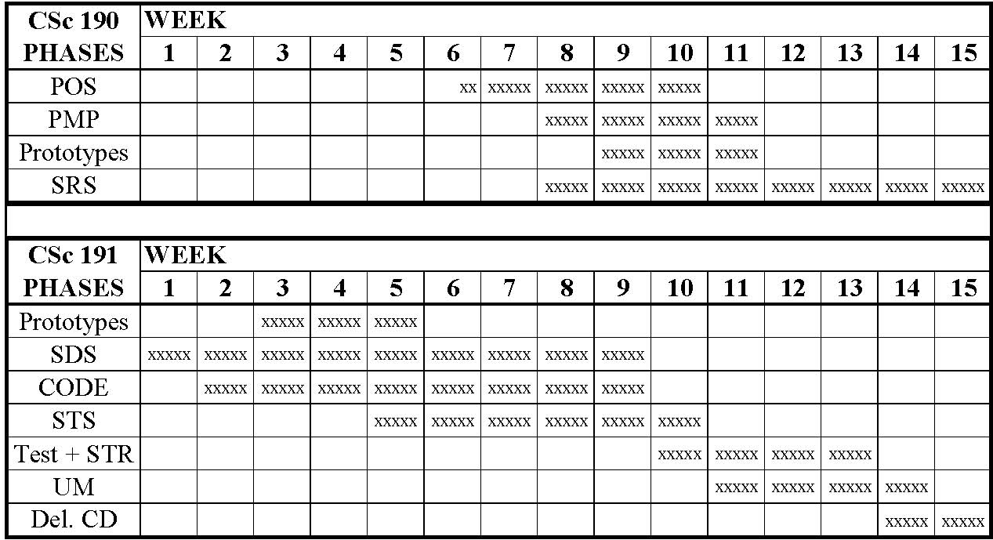
Appendix C: Phases of Work
Covers both CSC 190 and 191.
Tables of:
Phase / Deliverable / Approvals Required.
Phase / Estimated % of Work / Hours.
Week per week schedule of phases.

